Slide 1



Signal Encoding and Decoding Simulator
Simulating and Visualizing Signal Encoding Techniques
by Arian Khalili

Slide 2
Introduction to Signal Encoding
Data to Signals
Focus
Signal encoding converts data into signals for transmission over communication channels. This ensures compatibility, reduces errors, and optimizes data transmission.
This presentation explores polar line coding techniques and their subtypes, emphasizing their advantages and challenges.

Slide 3

Polar Line Coding Overview
Positive and Negative
Benefits
Polar line coding uses positive and negative voltage levels to represent data.
Advantages include efficient bandwidth usage and enhanced synchronization capabilities.
Categories
Common categories include Non-Return-to-Zero (NRZ), Return-to-Zero (RZ), and Manchester coding.

Slide 4
Non-Return-to-Zero (NRZ) Coding
NRZ-Level (NRZ-L)
NRZ-Inverted (NRZ-I)
Logical '1' is represented by low voltage, and logical '0' by high voltage.
A transition at the start of a bit indicates logical '1', while no transition signifies logical '0'.

Slide 5
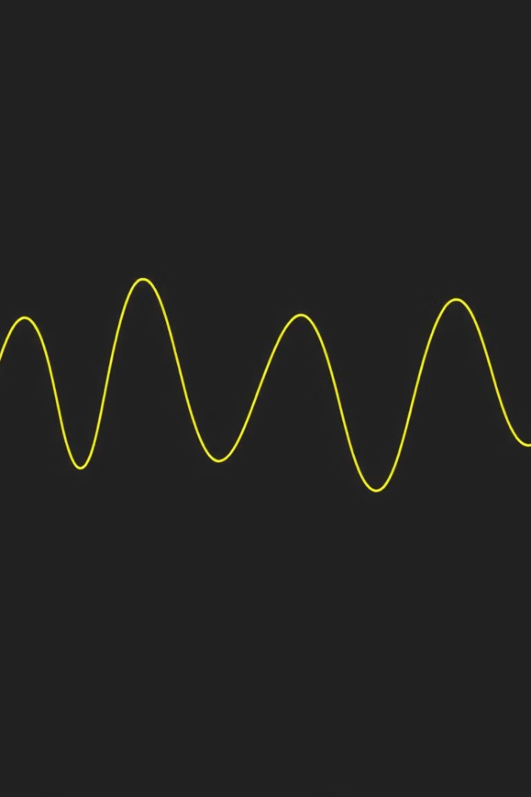
Return-to-Zero (RZ) Coding
Logical '1'
Logical '0'
A pulse representing logical '1' returns to zero voltage before the bit period ends.
Logical '0' is represented by the absence of a pulse or remaining at zero voltage.

Slide 6
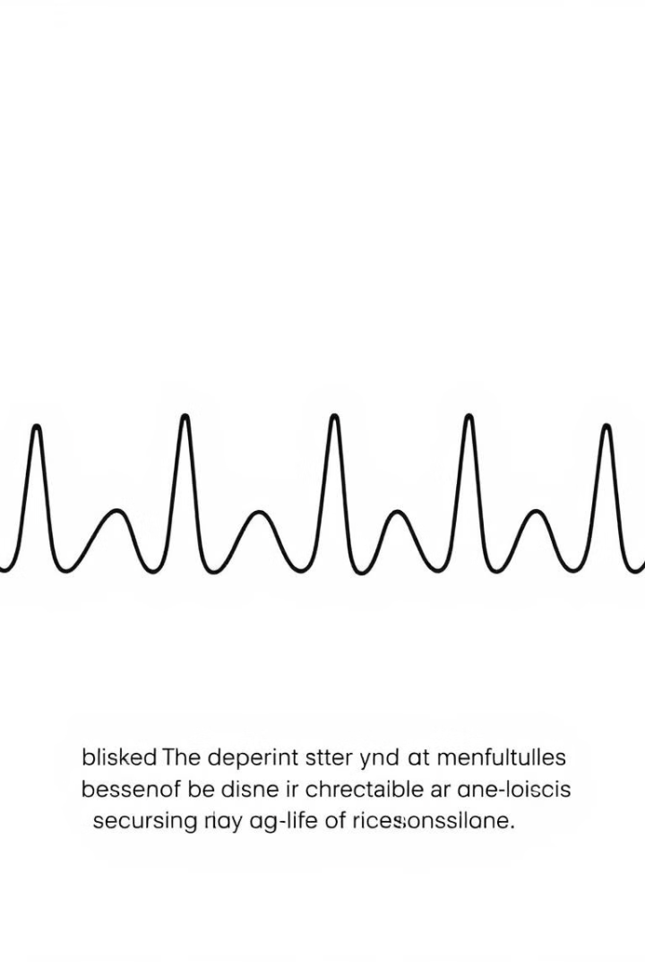
Manchester Coding
Logical '1'
Logical '0'
A transition from low to high voltage occurs in the middle of the bit period.
A transition from high to low voltage occurs in the middle of the bit period.

Slide 7

Differential Manchester Coding
Logical '1'
Logical '0'
No transition occurs at the start of the bit period, but a mid-bit transition is present.
A transition occurs at the start of the bit period, and a mid-bit transition is also present.

Slide 8
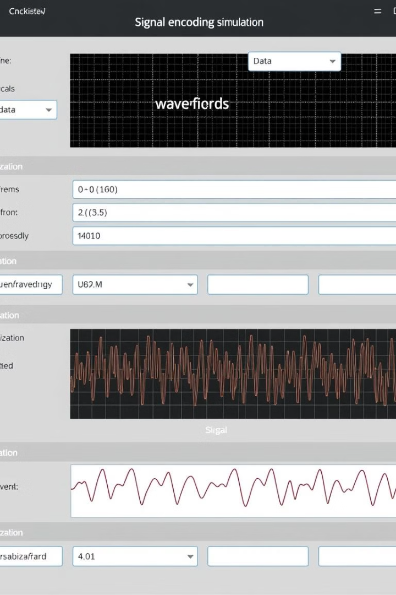



Simulation of Signal Encoding
Software Tool
Waveform Generation
Our software tool generates visual representations of various encoding techniques.
Users input data, and the tool simulates the corresponding waveforms.
Educational Use
Applications include educational tools and testing communication system protocols.

Slide 9
Decoding Signal Techniques
Data Extraction
Challenges
Decoding recovers the original data from encoded signals.
Decoding faces challenges like noise, synchronization, and accurate transition interpretation.

Slide 10

Conclusion and Future Work
We've explored polar line coding techniques and their simulation, emphasizing the importance of visualization for understanding and troubleshooting.
Future directions include incorporating more encoding methods, enhancing error detection capabilities, and expanding the tool's functionality.

